Slide 1


Slide 2
About today…
File
Upload file
Storing file

Slide 3

FILE UPLOAD

Slide 4


File upload
Importance
Enables to share content, contribute data, automate workflows, and personalize
their experience
Scenarios
User profile pictures
Document uploads
Media files
Impact
User experience
Application functionality

Slide 5
File upload Basics
Types of files
Images
Documents
Videos
Audio
Archives
Code Files
Supported formats
Images
JPEG
PNG
GIF
BMP
TIFF
SVG
ICO
etc
Documents
PDF
DOCX
XLSX
PPTX
TXT
CSV
ODT
etc
Videos
MP4
AVI
MOV
WMV
MKV
FLV
WebM
etc
Audio
MP3
WAV
AAC
FLAC
OGG
AIFF
etc
Archives
ZIP
RAR
TAR
GZ
7Z
ISO
etc
Code files
HTML
CSS
JavaScript
Python
Java
C++
Ruby
etc
Miscellaneous
XML
JSON
SQL
CSV
LOG
SRT
etc

Slide 6
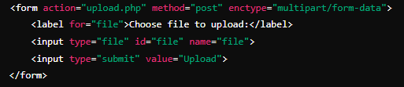
Frontend Components
HTML
For file input

Slide 7
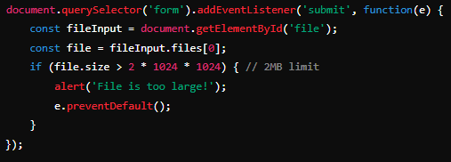
Frontend Components
JavaScript
For client-side validation

Slide 8
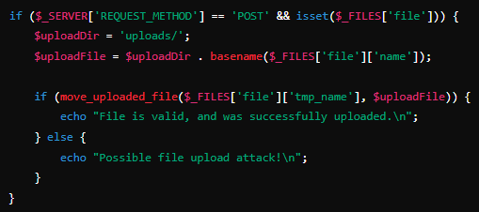
Backend Processing
Handling File Uploads on the Server-Side in PHP

Slide 9


Slide 10

What is the global variable used to handle file uploads in PHP?
What attribute must be included in the <form> tag to allow file uploads?
Which of the following is a valid method to check if a file was successfully uploaded in PHP?

Slide 11

Task 1
Create a simple HTML form that allows users to upload a file. Write a PHP script that handles the file upload and saves it to a directory named uploads.
Task 2
Create a PHP script that reads the uploads directory and displays a list of uploaded files with download links

